Slide 1


Windows Automation
Piotr Rogala

Slide 2
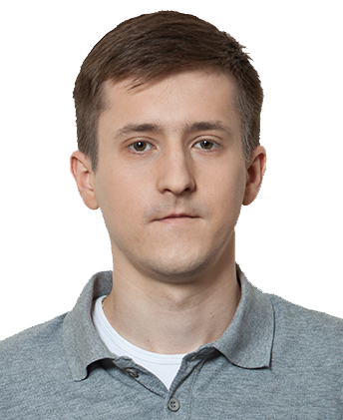

About me
Current working in IBM
Blog: http://justcloud.pl
Group leader: Microsoft Azure User Group Poland
http://azureug.org
Getting involve Azure solutions

Slide 3
CHEF
DevOps
Automation
Agile
Support for Windows
Support for Linux
Documentation
AWS, Azure, Google Cloud, OpenStack, VMware

Slide 4
CHEF and Windows?
https://supermarket.chef.io/
https://www.chef.io/solutions/windows/
Support for Windows
Azure
DSC
PowerShell

Slide 5
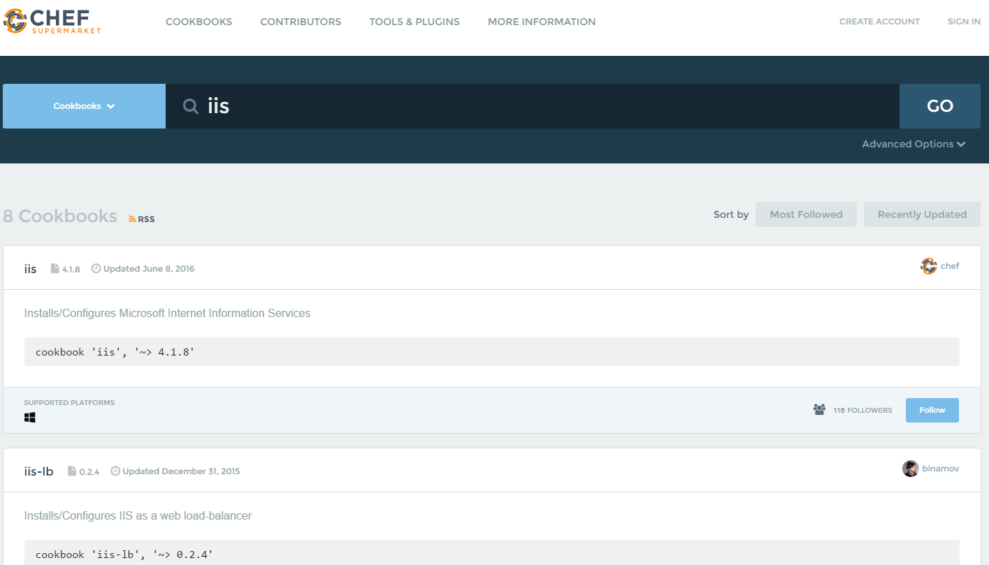

Slide 6
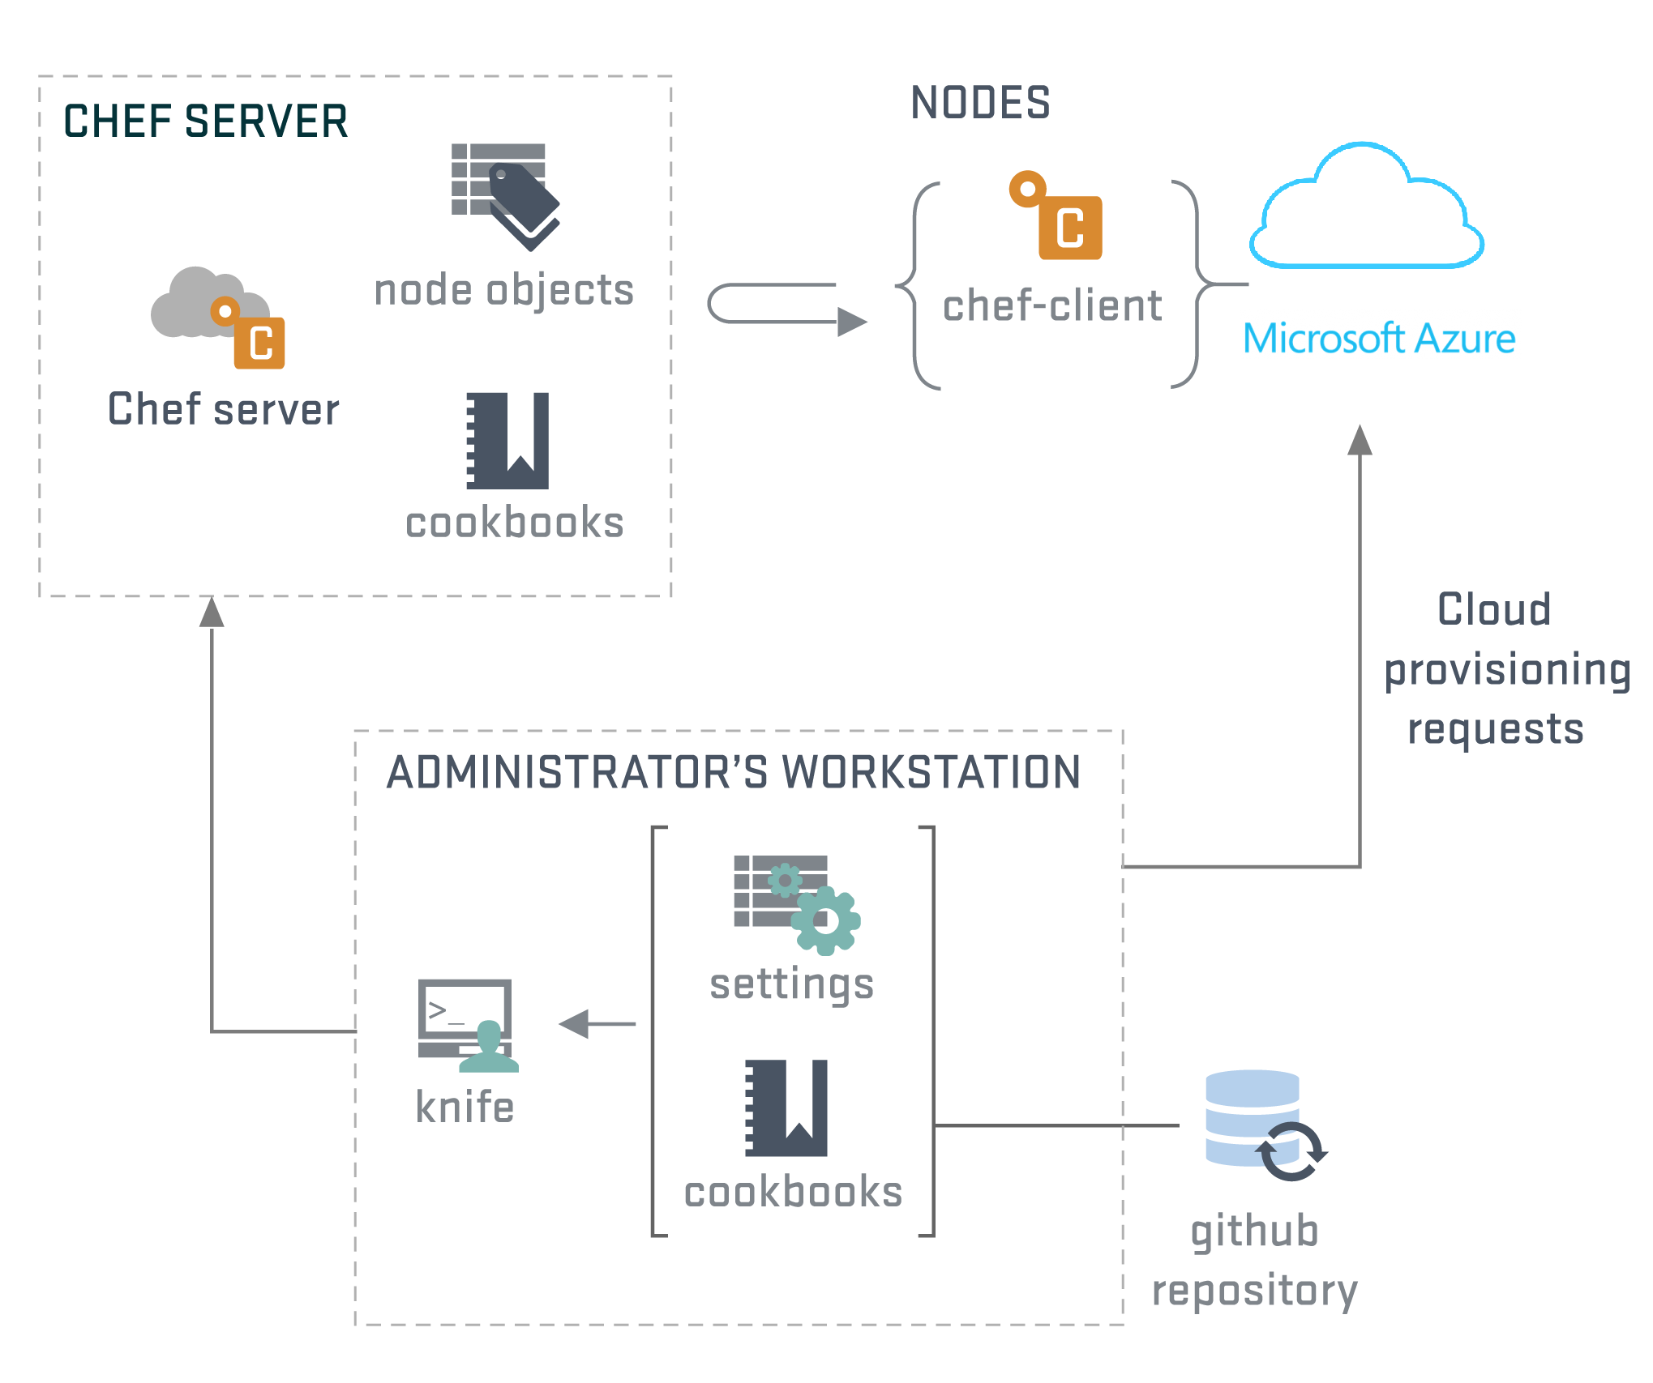
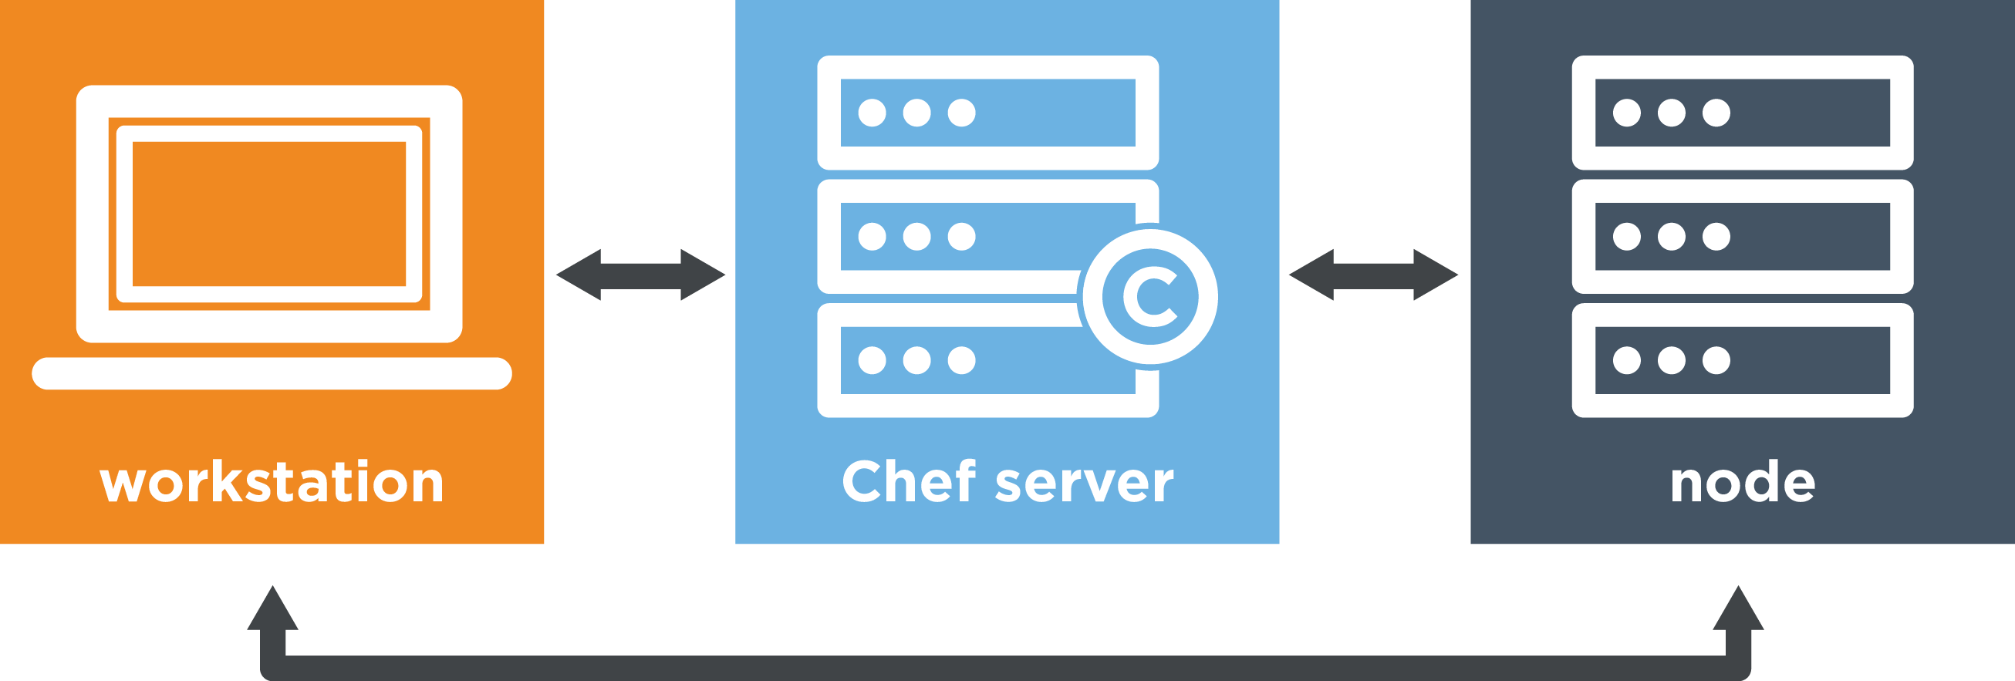
CHEF Infrastructure

Slide 7
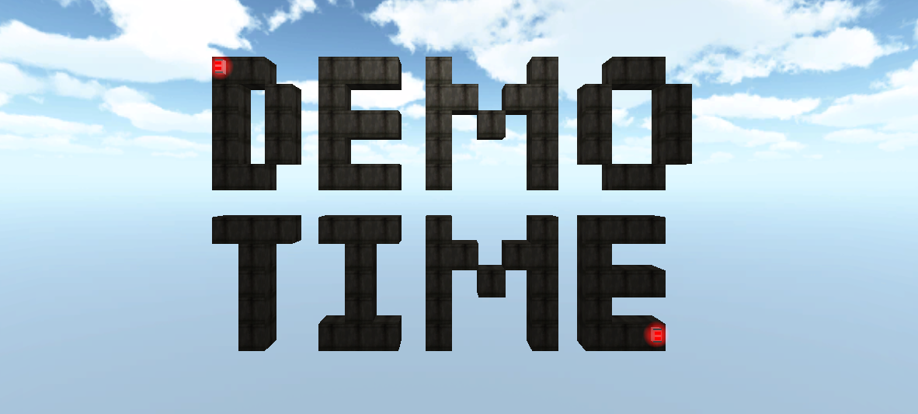

Slide 8
Links – http://devops.justcloud.pl
https://azure.microsoft.com/en-us/documentation/articles/virtual-machines-windows-chef-automation/
https://downloads.chef.io/chef-dk/windows/
https://downloads.chef.io/chef-client/
https://learn.chef.io
https://supermarket.chef.io/
http://berkshelf.com/

Slide 9
http://devops.justcloud.pl
Questions?
Thank you!
Piotr Rogala

